Slide 1




Smart Vitals
A portable health monitoring system
Presented by: Soya Shrestha

Slide 2



Introduction to Smart Vitals
Aims and Objectives
Methodology
System Architecture
System Overview
Obstacles Encountered
Potential Future Development
Conclusion
Table of Contents

Slide 3




Introduction to Smart Vitals
Measures and tracks vital signs
Offers a compact system
Mobile app integration
Ideal for home and travel use

Slide 4

Aims and Objectives
Objectives
Integration of different sensors
Aims
Instant display on OLED
real-time and remote
monitoring
Mobile application for remote access
affordable and user-friendly
solution
Firebase authentication
Alerts for abnormal readings
User guidance for correct sensor use

Slide 5
Agile Methodology
Incremental Development
Flexibility
Enabled building the system in small, testable modules
Allowed frequent adjustments
Faster Problem Resolution
Helped identify and fix issues early through continuous feedback and testing

Slide 6

System Components
Hardware Components
ESP 32 WROVER TYPE B
2. MAX30102
Software Components
3. AD8232
Arduino IDE
4. 10K NTC Temperature Sensor
5. MQ-135
2. VS Code (Flutter, Dart)
6. DHT22
3. Firebase
7. GPS Module
8. 1.3 “ OLED
9. Push Button
10. Reset Button
11. Battery
12. Power bank Module

Slide 7
System
Architecture
Hardware Components
ESP 32 WROVER TYPE B
Software Components
3. AD8232
2. MAX30102
4. 10K NTC Temperature Sensor
5. MQ-135
6. DHT22
7. GPS Module
8. 1.3 “ OLED
9. Push Button
10. Reset Button
11. Battery
12. Power bank Module

Slide 8
Data Flow Diagram
System Overview
Wireframe
Smart Vitals Device
&
Mobile Application

Slide 9
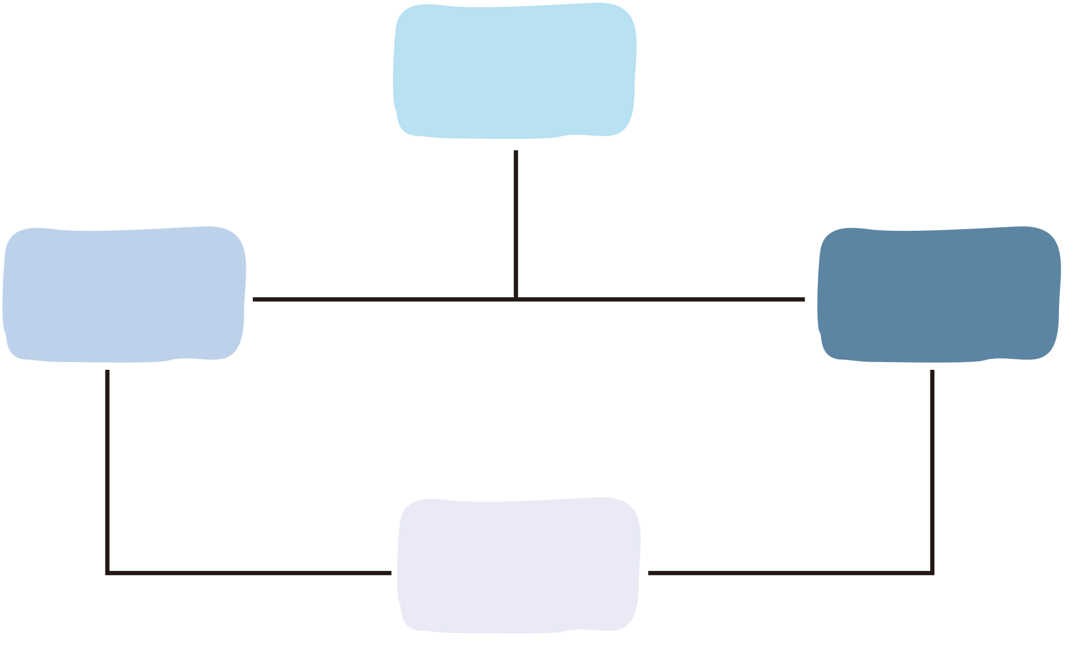
Data Flow Diagram

Slide 10
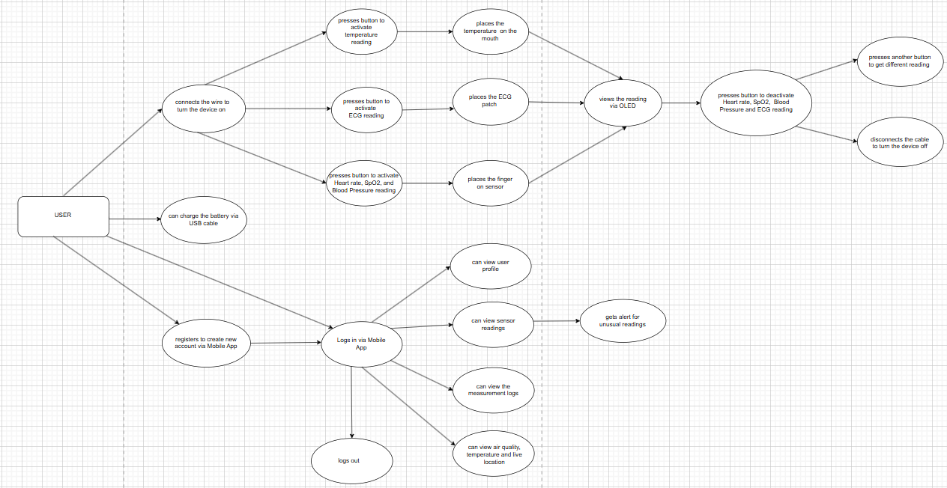

Slide 11

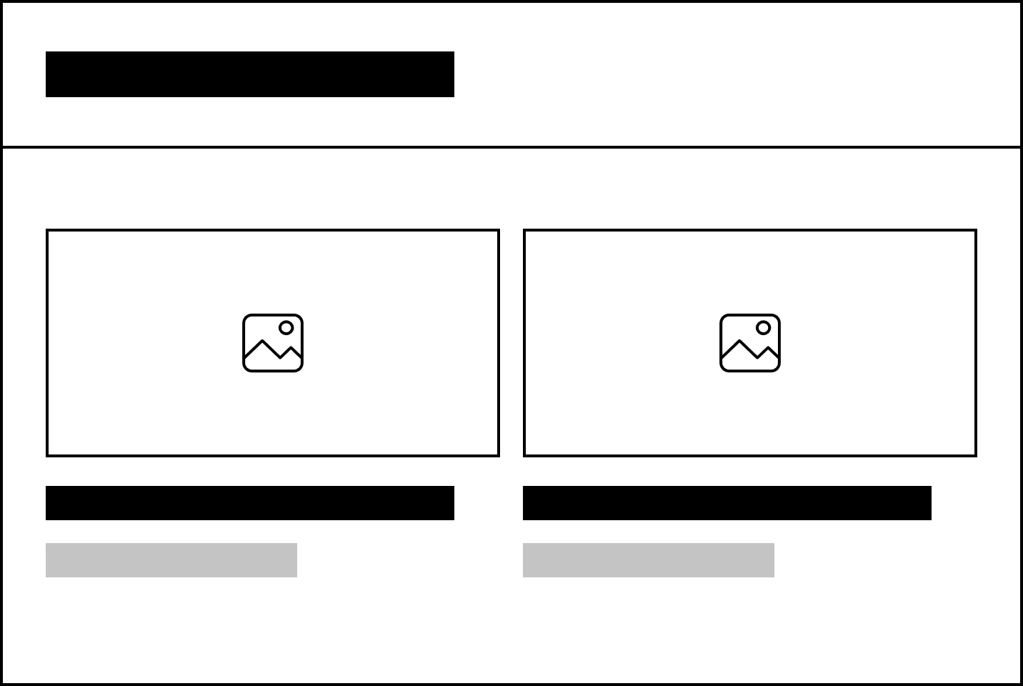
Wireframe

Slide 12
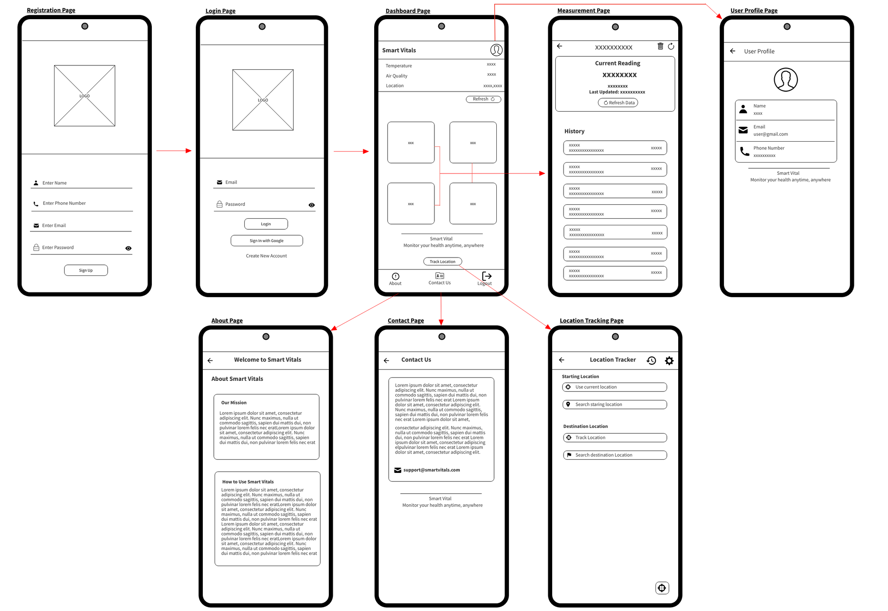

Slide 13
Smart Vitals Device
Smart
Vitals

Slide 14
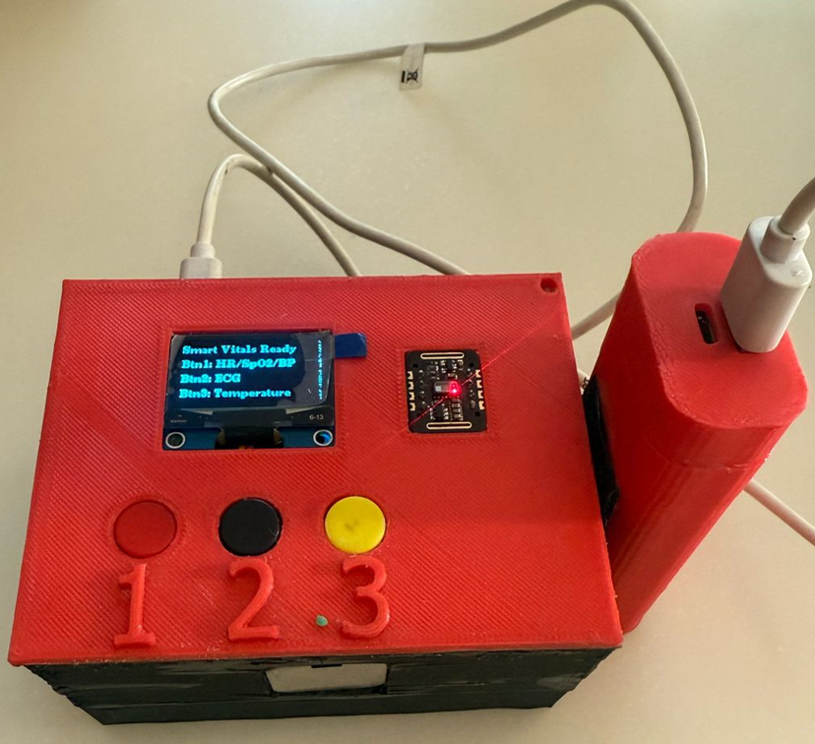
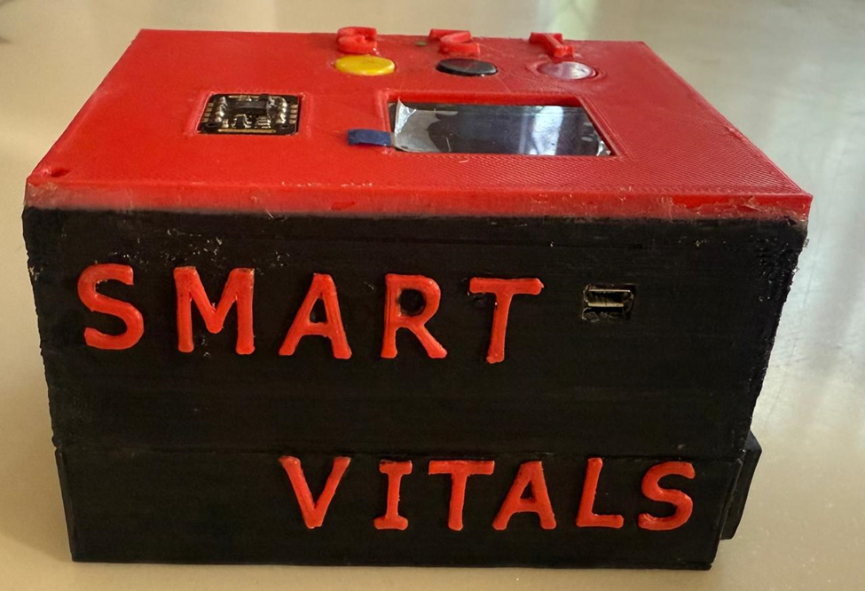

Slide 15

Smart Vitals Mobile App

Slide 16
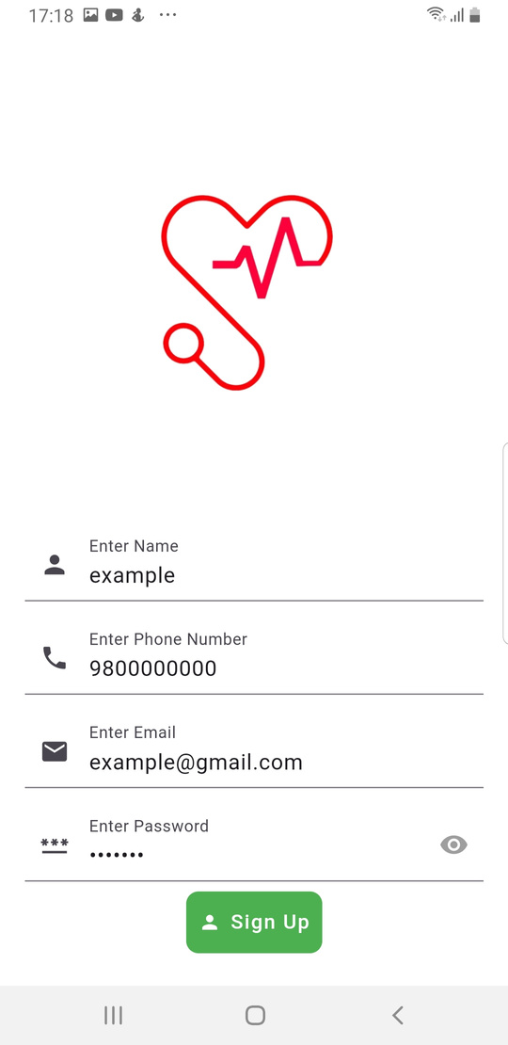
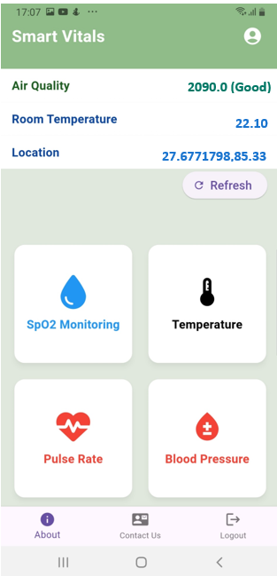
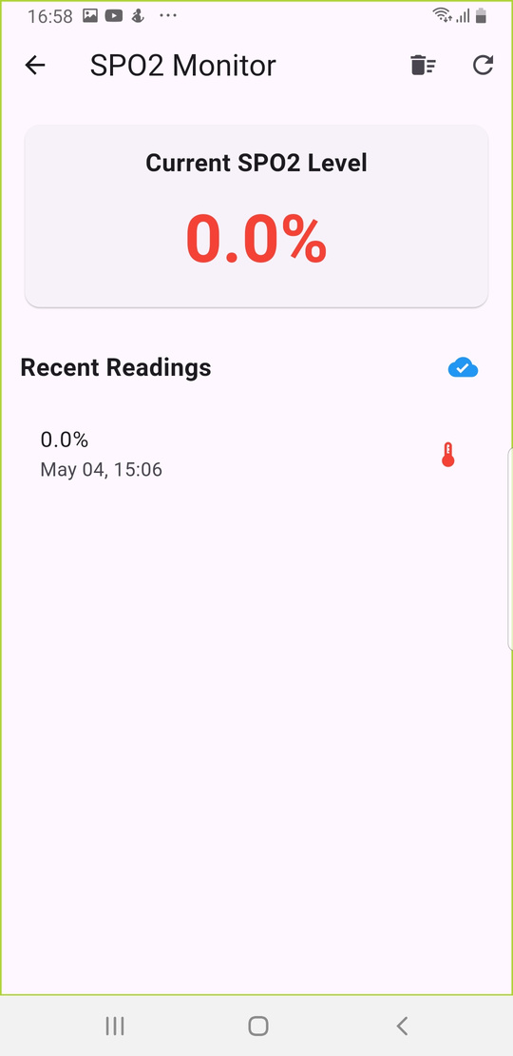
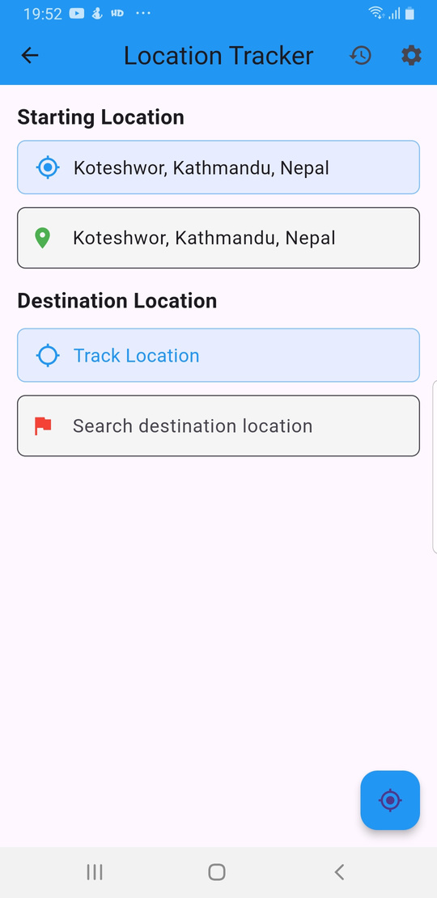

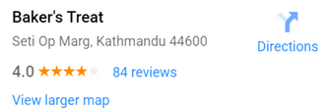
Sign Up Page
Home Page
Vitals Page
Location Page

Slide 17

Obstacles Encountered
01
02
Integration of all the sensors together in the device
Sensor calibration process
03
04
Battery power drainage from using the sensors
Excessive Data Logging and Synchronization

Slide 18






Potential Future
Developments
Integrate AI to detect health trends
Extend battery life
Multi-language UI
Telemedicine
Integration

Slide 19
Conclusion
Smart Vitals offers an accessible, real-time solution for personal health monitoring
With sensor integration, alerts, and mobile access, it empowers users to track vital signs anytime, anywhere
Smart Vitals is a small yet impactful step toward advancing healthcare through IoT

Slide 20
Thank you for your attention

